Slide 1
International Economic Relations ECON 308
Labor Productivity and Comparative Advantage: The Ricardian Model
(Chapter 3 Part 1)
Instructor: Muhebullah Karimzada
Notes:
If this PowerPoint presentation contains mathematical equations, you may need to check that your computer has the following installed:
1) MathType Plugin
2) Math Player (free versions available)
3) NVDA Reader (free versions available)

Slide 2
Learning Objectives
3.1 Explain how the Ricardian model, the most basic model of international trade, works and how it illustrates the principle of comparative advantage.
3.2 Demonstrate gains from trade and refute common fallacies about international trade.
3.3 Describe the empirical evidence that wages reflect productivity and that trade patterns reflect relative productivity.

Slide 3
Introduction
Differences across countries are a key reason why trade occurs:
The Ricardian model examines differences in the productivity of labor (due to differences in technology) between countries.
The Specific Factors model and the Heckscher-Ohlin model examine differences in labor, labor skills, physical capital, land, or other factors of production between countries.
Trade may also arise due to economies of scale (larger scale of production is more efficient).

Slide 4
The Concept of Comparative Advantage (1 of 6)
The opportunity cost of producing something measures the cost of not being able to produce something else with the resources used.
Comparative advantage will be determined by comparing opportunity costs across countries.

Slide 5
The Concept of Comparative Advantage (2 of 6)
A simple example with roses and computers explains the intuition behind the concepts of opportunity cost and comparative advantage in the Ricardian model.
For example, suppose a limited number of workers could produce either roses or computers.
The opportunity cost of producing computers is the amount of roses not produced.
The opportunity cost of producing roses is the amount of computers not produced.

Slide 6
The Concept of Comparative Advantage (3 of 6)
Suppose that in the United States, 10 million roses could be produced with the same resources as 100,000 computers.
Suppose that in Colombia, 10 million roses could be produced with the same resources as 30,000 computers.
Colombia has a lower opportunity cost of producing roses: has to start producing fewer computers in order to free up resources to make a rose.

Slide 7
The Concept of Comparative Advantage (4 of 6)
A country has a comparative advantage in producing a good if the opportunity cost of producing that good is lower in the country than in other countries.
The United States has a comparative advantage in computer production.
Colombia has a comparative advantage in rose production.

Slide 8
The Concept of Comparative Advantage (5 of 6)
Suppose initially that Colombia produces computers and the United States produces roses, and that both countries want to consume computers and roses.
Can both countries be made better off?

Slide 9
Table 3.1 Hypothetical Changes in Production
Blank | Million Roses | Thousand Computers
United States | negative 10 | +100
Columbia | +10 | negative 30
Total | 0 | +70

Slide 10
The Concept of Comparative Advantage (6 of 6)
When countries specialize in production in which they have a comparative advantage, more goods and services can be produced and consumed.
Have the United States stop growing roses and use those resources to make 100,000 computers instead. Have Colombia stop making 30,000 computers and grow roses instead.
If produce goods in which have a comparative advantage (the United States produces computers and Colombia produces roses), they could still consume the same 10 million roses, but
could consume
more computers.

Slide 11
A One-Factor Economy (1 of 4)
We formalize these ideas by constructing a one-factor Ricardian model using the following assumptions:

Slide 12
A One-Factor Economy (2 of 4)
Labor is the only factor of production.
Labor productivity varies across countries due to differences in technology, but labor productivity in each country is constant.
The supply of labor in each country is constant.
Two goods: wine and cheese.
Competition allows workers to be paid a wage equal to the value of what they produce, and allows them to work in the industry that pays the higher wage.
Two countries: home and foreign.

Slide 13
A One-Factor Economy (3 of 4)
A unit labor requirement indicates the constant number of hours of labor required to produce one unit of output.
is the unit labor requirement for cheese in the home
country.
hours of labor produce one pound of cheese
in the home country.
is the unit labor requirement for wine in the home
country.
hours of labor produce one gallon of wine
in the home country.
A high unit labor requirement means low labor productivity.
Labor productivity is how much output one hour of labor creates.

Slide 14
A One-Factor Economy (4 of 4)
Labor supply L indicates the total amount of labor resources—the number of hours worked (a constant parameter).
indicates the amount of labor required for each pound of
cheese produced (a constant).
Cheese production
indicates how many total pounds of cheese
that the home country produces.
indicates the amount of labor required for each gallon of wine
produced (a constant).
Wine production
indicates how many total gallons of
wine that the home country produces.

Slide 15
Production Possibilities (1 of 6)
The production possibility frontier (P P F) of an economy shows the maximum amount of a goods that can be produced for a fixed amount of resources.
The PPF of the home economy is

Slide 16
Production Possibilities (2 of 6)
Maximum home cheese production is
Maximum home wine production is

Slide 17
Production Possibilities (3 of 6)
For example, suppose that the home economy’s labor supply is 1,000 hours.
so one hour of labor produces one pound of
cheese in the home country.
so two hours of labor produces one
gallon of wine in the home country.
The P P F equation
Maximum cheese production is 1,000 pounds.
Maximum wine production is 500 gallons.

Slide 18
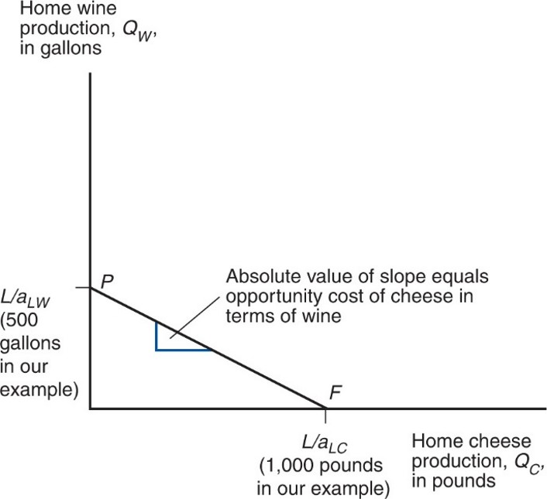
Figure 3.1 Home’s Production Possibility Frontier
The line P F shows the maximum amount of cheese Home can produce given any production of wine, and vice versa.
Notes:
The line, P F, shows the maximum amount of cheese, home can produce given any production of wine, and vice versa. This line falls from point P on the y-axis at ratio L over a, sub L W, 500 gallons in the example, to point F on the x-axis, ration L over a sub L C, 1,000 pounds. The absolute value of the slope equals the opportunity cost of cheese in terms of wine.

Slide 19
Production Possibilities (4 of 6)
The opportunity cost of cheese is how many gallons of wine Home must stop producing in order to make one more pound of cheese:
The opportunity cost is constant because the unit labor requirements are both constant.
The opportunity cost of cheese appears as the absolute value of the slope of the P P F.

Slide 20
Production Possibilities (5 of 6)
Producing an additional pound of cheese requires
hours of labor.
Each hour devoted to cheese production could have been used instead to produce an amount of wine equal to
Notes:
Start fraction 1 hour over left parenthesis a sub start expression L W end expression hours per gallon of wine right parenthesis end fraction = left parenthesis start fraction 1 over a sub start expression L W end expression end fraction right parenthesis gallons of wine

Slide 21
Production Possibilities (6 of 6)
For example, if one hour of labor is moved to cheese production, that additional hour could have produced
Opportunity cost of producing one pound of cheese is
gallon of wine not produced.

Slide 22
Relative Prices and Supply (1 of 7)
is the price of cheese;
is the price of wine.
is the wage paid to workers who make cheese, and
is the wage paid to workers who make wine.
Due to competition in the labor and goods markets:
Hourly wages of cheese makers will equal the value of the cheese produced in an hour:
Hourly wages of wine makers will equal the value of the wine produced in an hour:

Slide 23
Relative Prices and Supply (2 of 7)
Workers will choose to work in the industry that pays the higher wage.
If the price of cheese relative to the price of wine exceeds the opportunity cost of producing cheese
Then the wage paid when making cheese will exceed the wage in wine
So workers will make only cheese (the economy specializes in cheese production).

Slide 24
Relative Prices and Supply (3 of 7)
If the price of cheese relative to the price of wine is less than the opportunity cost of producing cheese
Then the wage in cheese will be less than the wage in wine
So workers will make only wine (the economy specializes in wine production).

Slide 25
Relative Prices and Supply (4 of 7)
If the price of cheese relative to the price of wine equals the opportunity cost of producing cheese
Then the wage in cheese will equal the wage in wine
So workers will be willing to make both wine and cheese.

Slide 26
Relative Prices and Supply (5 of 7)
For example, suppose cheese sells for
and wine sells for
Wage paid producing cheese is
Wage paid producing wine is
Workers would be willing to make only cheese (the relative price
of cheese
exceeds the opportunity cost of cheese

Slide 27
Relative Prices and Supply (6 of 7)
If the price of cheese drops to
Wage paid producing cheese drops to
Wage paid producing wine is still
if price of
wine is still
Now workers would be willing to make only wine (the relative
price of cheese
is now less than the opportunity cost of
cheese

Slide 28
Relative Prices and Supply (7 of 7)
If the home country wants to consume both wine and cheese (in the absence of international trade), relative prices must adjust so that wages are equal in the wine and cheese industries.
If
workers will not care whether they work in the
cheese industry or the wine industry, so that production of both goods can occur.
Production (and consumption) of both goods occurs when the relative price of a good equals the opportunity cost of producing that good:

